Slide 1


Shifting from NEDC to WLTP – What is the impact on 2025/30 CO₂ targets?
Florent Grelier, Clean Vehicles Engineer, T&E
Get Real conference Hungary | Shifting from NEDC to WLTP – What is the impact on 2025/30 CO₂ targets? | 5 February 2020

Slide 2
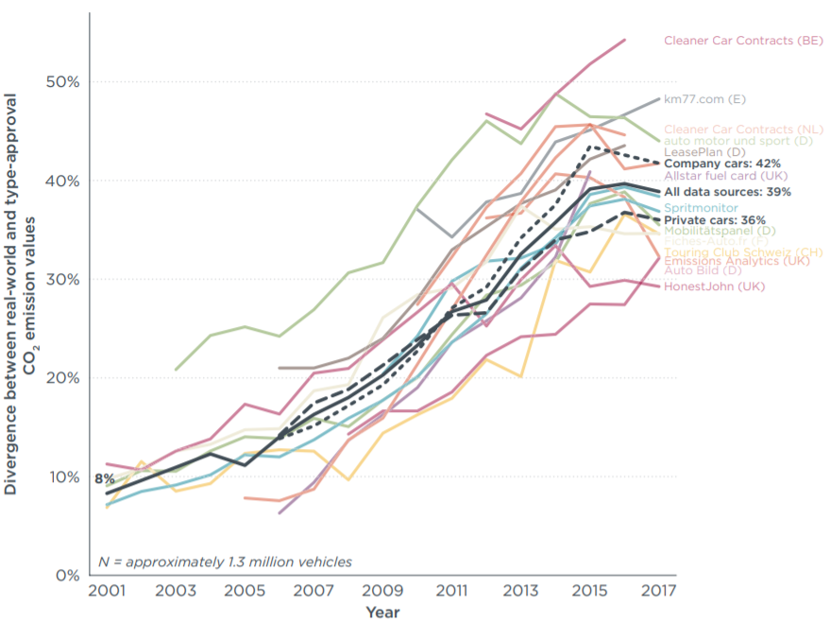
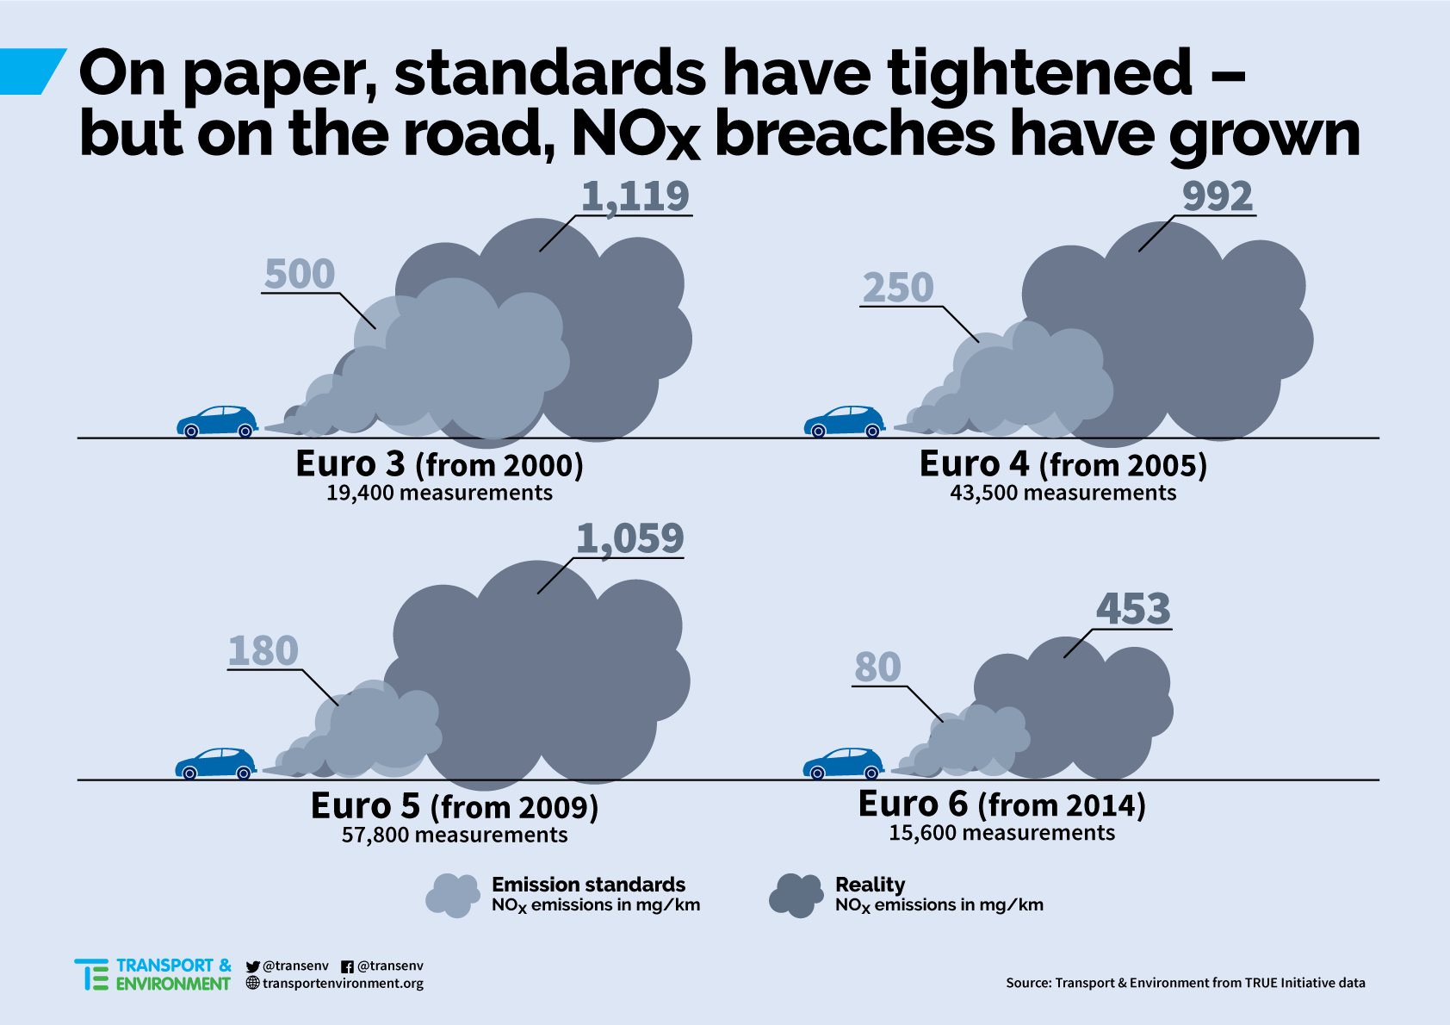
Dieselgate accelerated the transition to WLTP
(Source: ICCT)
(Source: T&E)
Get Real conference Hungary | Shifting from NEDC to WLTP – What is the impact on 2025/30 CO₂ targets? | 5 February 2020

Slide 3
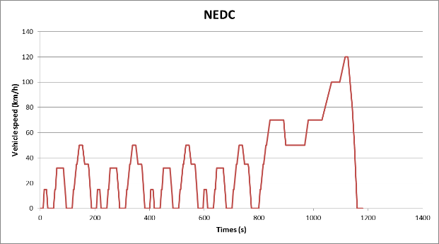
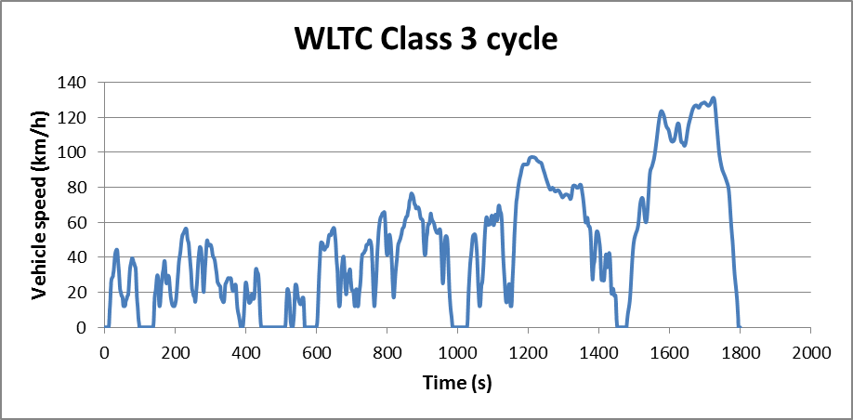
A double change in the regulation: the test procedure…
(Source: European Commission)
Get Real conference Hungary | Shifting from NEDC to WLTP – What is the impact on 2025/30 CO₂ targets? | 5 February 2020

Slide 4
…with an impact on setting next EU CO₂ targets
2018
2021
2025/30
2020
All new cars are tested with WLTP with NEDC-equivalent CO₂ value
95 g/km NEDC CO₂ target
95 g/km NEDC CO₂ target converted to WLTP
New targets with percentage reduction from 2021 WLTP baseline
(-15% and -37.5%)
Lowest NEDC CO₂ (2020/21 targets)
Highest WLTP CO₂ (2025/30 targets)
Interest for OEMs for high “WLTP uplift”
WLTP/NEDC ratio in 2020
➔ “WLTP uplift”
Get Real conference Hungary | Shifting from NEDC to WLTP – What is the impact on 2025/30 CO₂ targets? | 5 February 2020

Slide 5
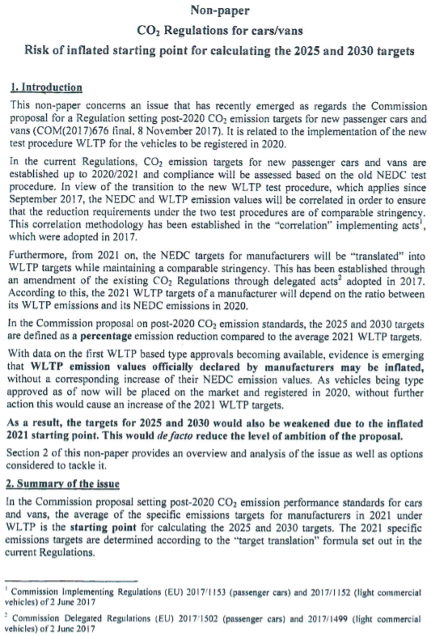


The inflation of WLTP uplift is already happening
“Declared” WLTP values ➔ +4.5% CO₂ (up to 13%)
“Measured” WLTP values ➔ +5% CO₂
- Empty battery
- Different gear shifting strategies
- Deactivation of stop-start system
Regulation 2018/2043:
Report measured & declared WLTP values
2021 baseline for 2025/30 targets calculated
with WLTP measured values
All fitted CO₂-saving technologies must be active
Battery charge correction compulsory
Clarification about gear shifting strategies
Apply for all cars registered in 2020
Re-do type-approval tests if needed
Get Real conference Hungary | Shifting from NEDC to WLTP – What is the impact on 2025/30 CO₂ targets? | 5 February 2020

Slide 6



EEA’s 2018 data gives a first overview
Early projections of the WLTP uplift mainly based on simulations
First data-based analysis with Dutch registration information
Most representative EU-wide dataset but from 2018
Limitations: provisional data, many NEDC-approved cars, before Commission’s amendments
Data filtration to keep the most relevant information only
Integration of 2020 projected segment and fuel shares + 2020 product planning
Estimated “measured” WLTP values
Work still in progress: preliminary results presented
Get Real conference Hungary | Shifting from NEDC to WLTP – What is the impact on 2025/30 CO₂ targets? | 5 February 2020

Slide 7

Current WLTP uplift is higher than expected
CO2 pool | Average | Diesel (ICE + MHEV) | Petrol (ICE + MHEV) | Petrol (FHEV) | Petrol (PHEV)
BMW Group | 22% | 24% | 22% |  | 18%
Daimler | 16% | 18% | 15% |  | -3%
FCA | 18% | 18% | 18%
Ford | 20% | 25% | 19% | 27%
Honda | 18% | 28% | 18%
Hyundai | 15% | 21% | 14% | 23% | 0%
Jaguar-Land Rover | 20% | 21% | 21% |  | 3%
Kia | 17% | 22% | 13% | 29% | 7%
Mitsubishi | 14% |  | 14% |  | 15%
Nissan | 25% | 35% | 21%
PSA Group | 23% | 27% | 22%
Renault Group | 18% | 23% | 16%
Suzuki | 18% |  | 18%
Toyota-Mazda | 22% | 24% | 17% | 26% | 0%
Volkswagen Group | 22% | 25% | 21% |  | 0%
Volvo | 22% | 23% | 16% |  | 33%
EU average | 21% | 24% | 19% | 26% | 19%
Uplift with “declared” values
Wide differences between carmakers
Full hybrids & diesels have highest uplift
Higher uplift for SUVs compared to hatchbacks and sedans:
Diesel ➔ 25% vs. 23%
Petrol ➔ 20% vs. 19%
Very similar results to 2018 picture
Absolute WLTP-NEDC difference (26 g/km) in line with TNO’s findings
Get Real conference Hungary | Shifting from NEDC to WLTP – What is the impact on 2025/30 CO₂ targets? | 5 February 2020

Slide 8
Current WLTP uplift is higher than expected
Uplift with “measured” values
WLTP values down by 4.5%
 | EU average | Diesel (ICE + MHEV) | Petrol (ICE + MHEV) | Petrol (FHEV)
Declared WLTP | 21% | 24% | 19% | 16%
Measured WLTP | 16% | 19% | 14% | 21%
10%
What are the consequences for 2025/30 CO₂ targets?
Get Real conference Hungary | Shifting from NEDC to WLTP – What is the impact on 2025/30 CO₂ targets? | 5 February 2020

Slide 9


2025/30 CO₂ targets could be undermined by 10%
Starting point | Uplift scenario |  | WLTP CO₂ (g/km) |  |  | Needed EV shares to meet targets
 |  |  | 2021 | 2025 | 2030 | 2025 | 2030
2021 | WLTPd | 21% | 115 | 98 | 72 | 15% | 36%
95 g/km (NEDC) | WLTPm | 16% | 110 | 94 | 69 | 19% | 39%
10% of EVs | JRC | 10% | 105 | 89 | 65 | 24% | 43%
The only difference in these scenarios is the WLTP uplift – Impacts are:
Difference of 2021 WLTP baseline up to 10 g/km
2025/2030 CO₂ targets increased by 5% - 10%
Needed EV shares to meet targets decreased by up to 9% (2025) and 7% (2030)
Undermining the needed transition to EVs towards climate neutrality in 2050
Get Real conference Hungary | Shifting from NEDC to WLTP – What is the impact on 2025/30 CO₂ targets? | 5 February 2020
Notes:
Assumptions:
More ZEVs in the EV mix by 2025/30 compared to 2021
Lower official CO2 emissions from PHEVs in 2025/30
ICE improvement & growing shares of mild and full hybrids by 2025/30

Slide 10
Summary
Double regulatory change (shift to WLTP, percentage reduction CO₂ targets)
2020 WLTP uplift = key of transition ➔ interest for carmakers to game system
Inflation of WLTP already happening ➔ amendments by European Commission
Current WLTP uplift higher than expected (16-21% instead of 10%)
Diesel, full hybrids & SUVs with highest WLTP uplift
Inflated WLTP uplift ➔ undermine 2030 CO₂ targets by 10% & needed EV sales by 7%
Get Real conference Hungary | Shifting from NEDC to WLTP – What is the impact on 2025/30 CO₂ targets? | 5 February 2020

Slide 11
Policy recommandations
European Commission:
Use new in-service conformity powers (type-approval regulation) ➔ independent WLTP tests & challenge testing parameters
Bring down WLTP values where evidence of inflated/unexpected uplift
Disclose publicly WLTP measured values for the cars registered in 2020
Use WLTP uplift with measured values also for the 2021-2024 CO₂ targets
Strenghten Fuel Consumption Meter (FCM) mechanism ➔ use for compliance (2021 review) to remove any incentive to manipulate laboratory tests
Member States:
Wait 2021 to adapt CO₂-based fiscal measures to WLTP to have the most accurate picture of uplift
Get Real conference Hungary | Shifting from NEDC to WLTP – What is the impact on 2025/30 CO₂ targets? | 5 February 2020

Slide 12

Thank you for your attention!
Get Real conference Hungary | Shifting from NEDC to WLTP – What is the impact on 2025/30 CO₂ targets? | 5 February 2020

